Slide 1
Image Segmentation

Slide 2
Image Segmentation
Image segmentation is a computer vision technique that assigns a label to every pixel in an image such that pixels with the same label share certain characteristics.

Slide 3
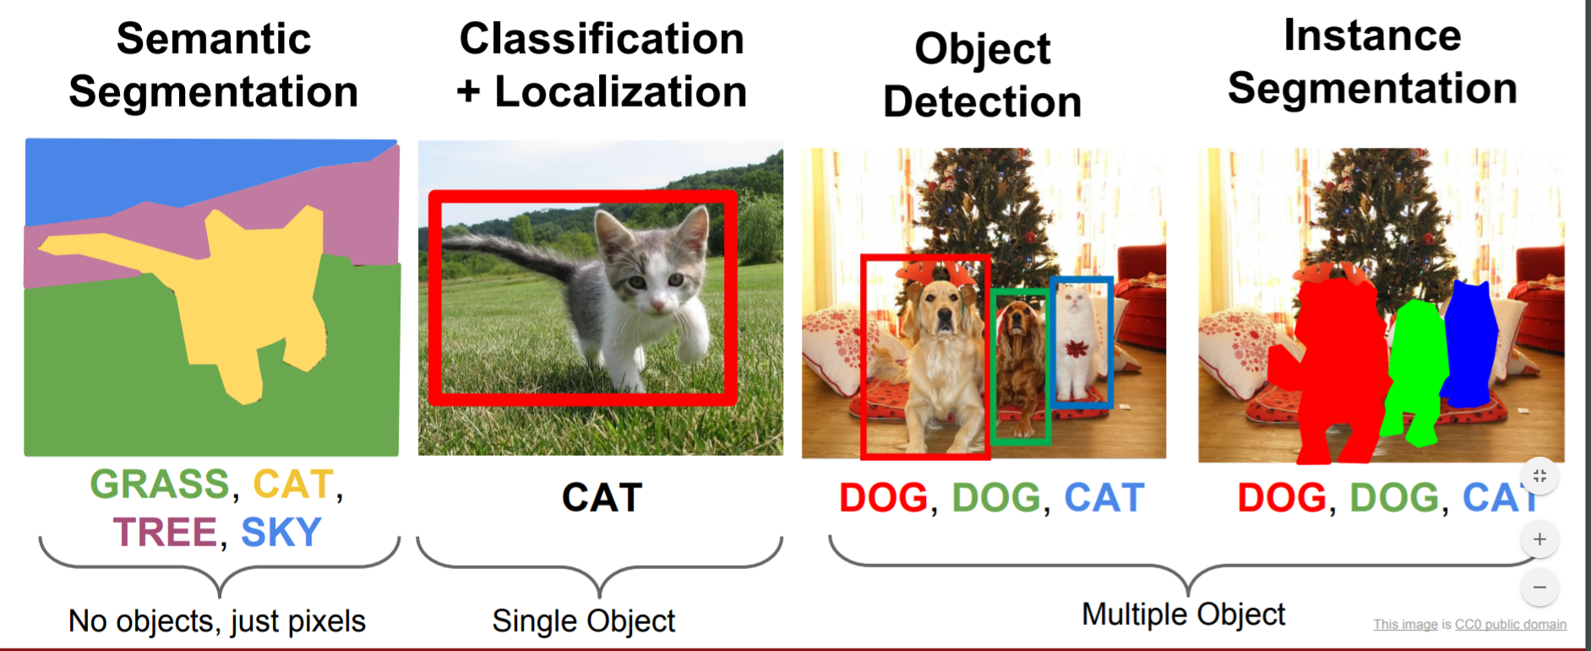

Slide 4
Types of Image Segmentation
Semantic segmentation classifies each pixel based on its semantic class. All the birds belong to the same class.
Instance segmentation assigns unique labels to different instances, even if they are of the same semantic class. Each bird belongs to a different class.
Panoptic segmentation combines the two, providing both class-level and instance-level labels. Each bird has its own class, but they are all identified as a “bird”.

Slide 5
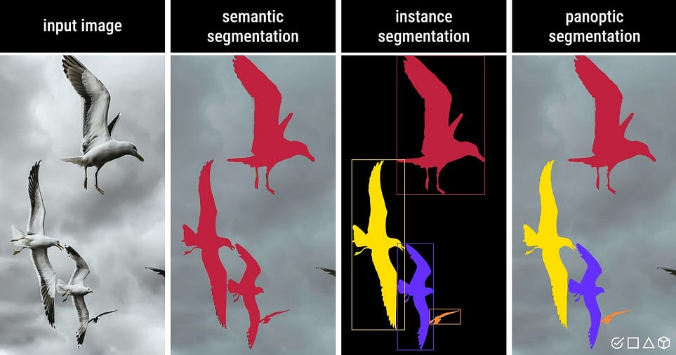

Slide 6
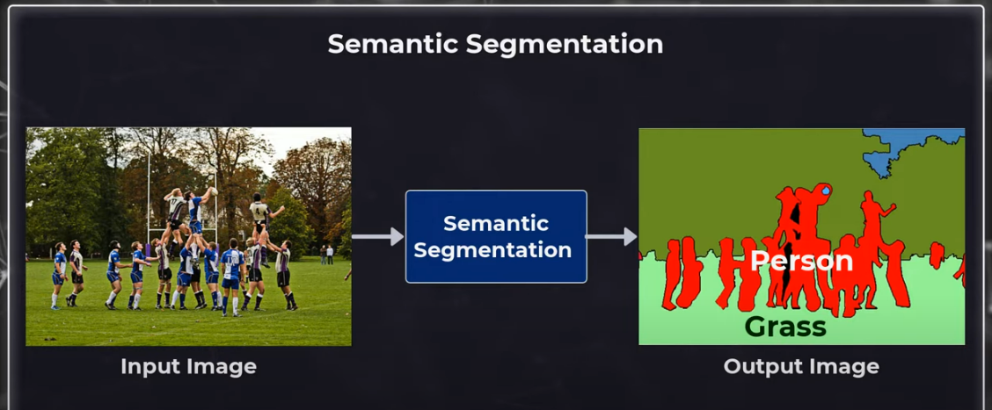

Slide 7
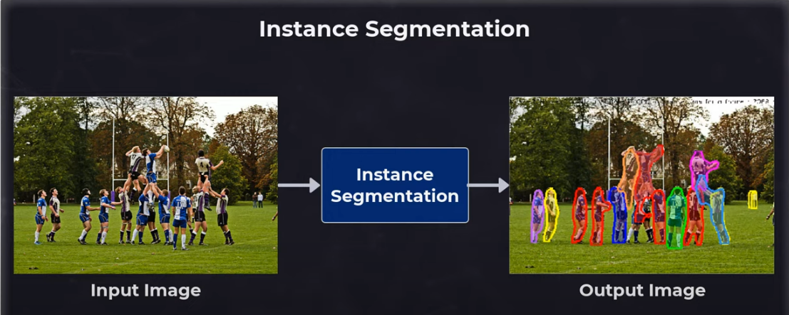

Slide 8
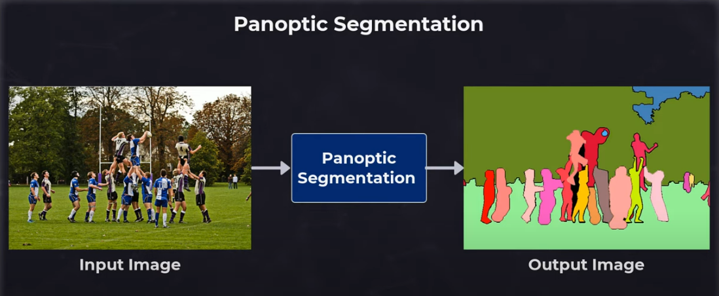

Slide 9
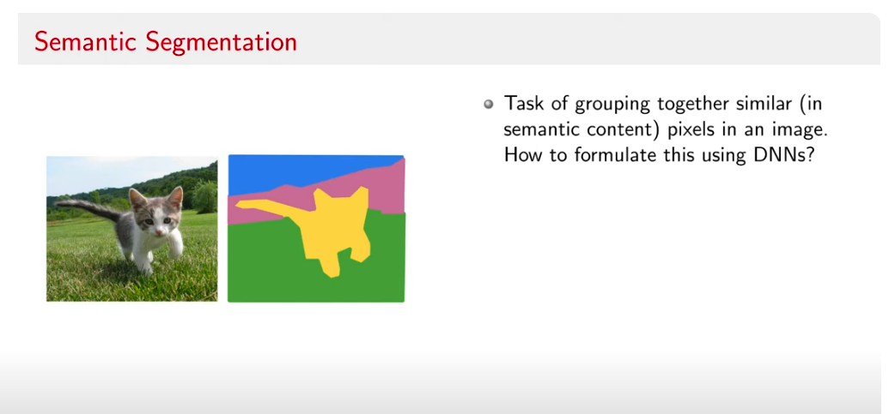

Slide 10
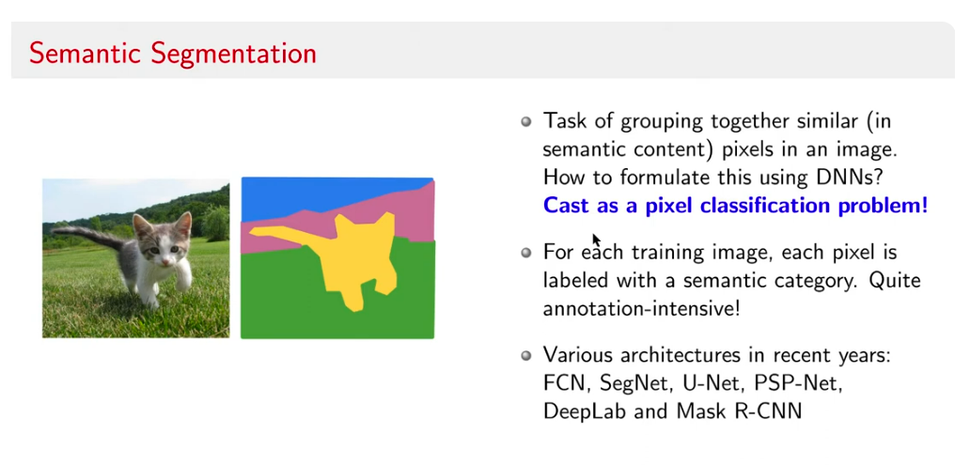

Slide 11
U-Net: Convolutional Neural Network for Image Segmentation
The U-Net architecture was initially designed for medical image segmentation, but it has since been adapted for many other use cases.
The U-Net has an encoder-decoder structure.
The encoder is used to compress the input image into a latent space representation through convolutions and downsampling.
The decoder is used to extrapolate the latent representation into a segmented image, through convolutions and upsampling.

Slide 12
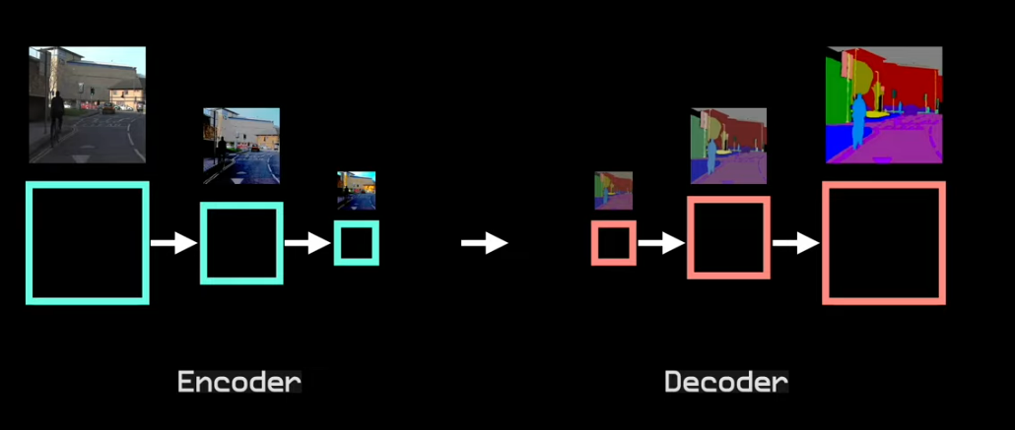

Slide 13
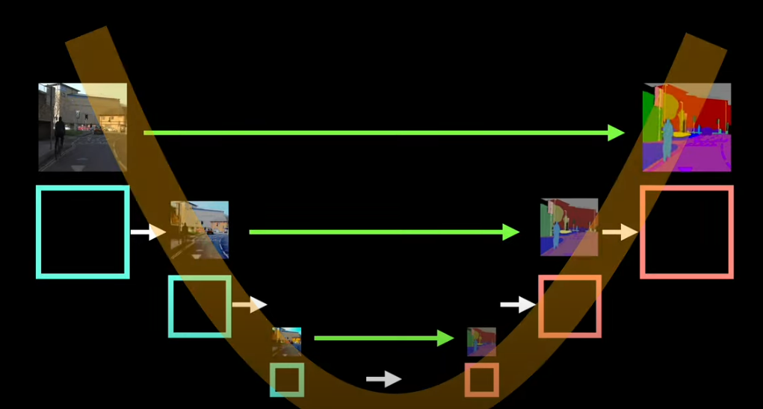

Slide 14
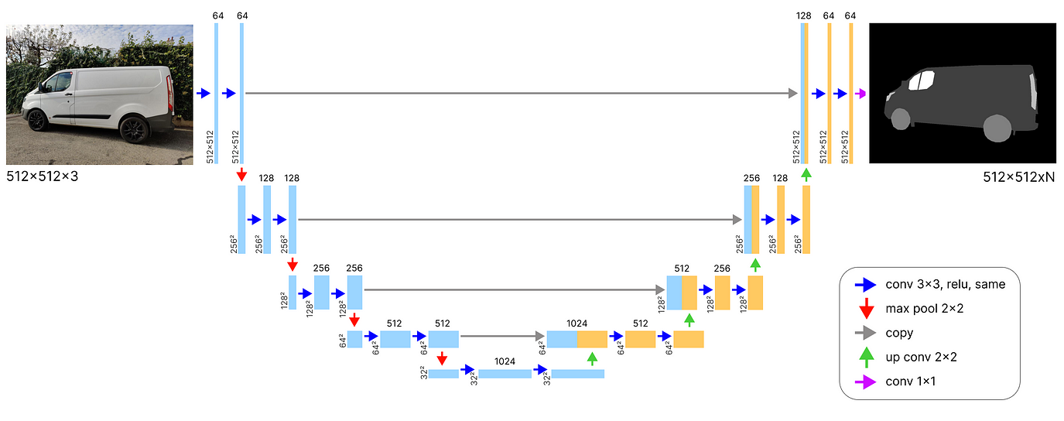

Slide 15
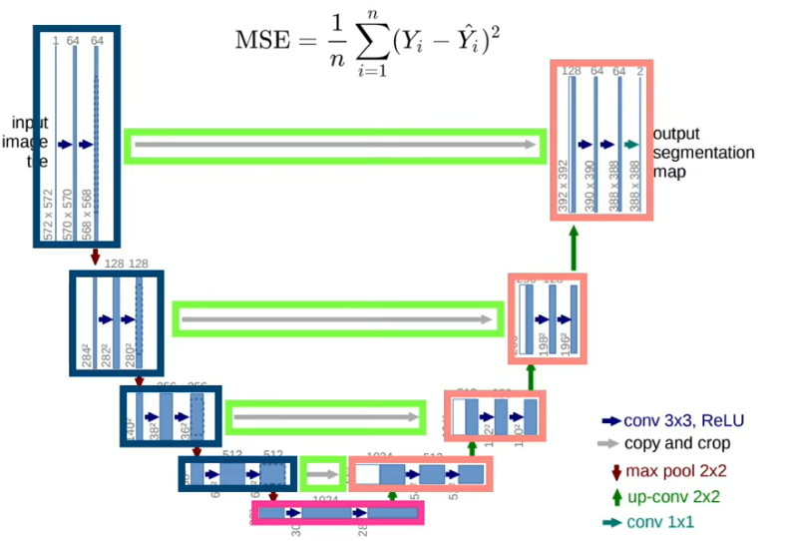

Slide 16
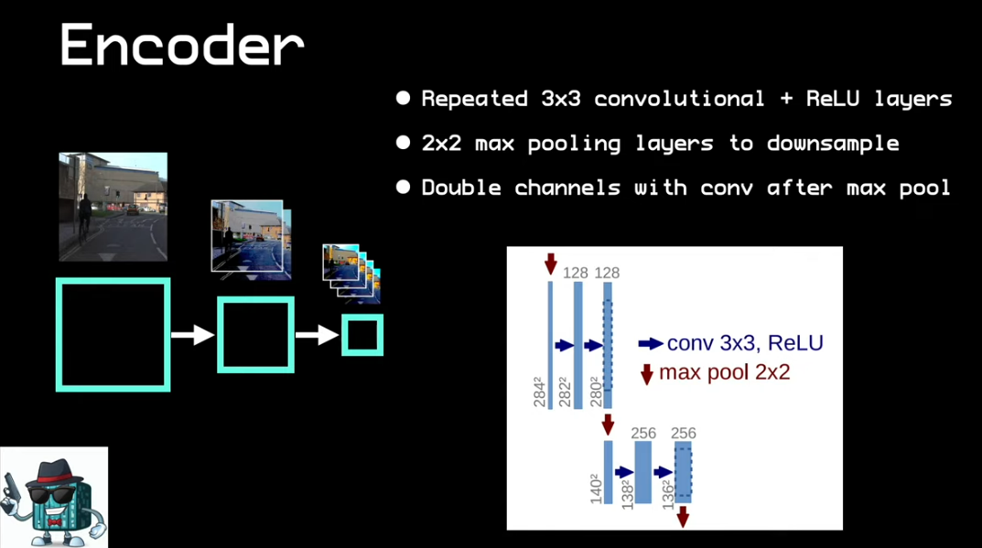

Slide 17
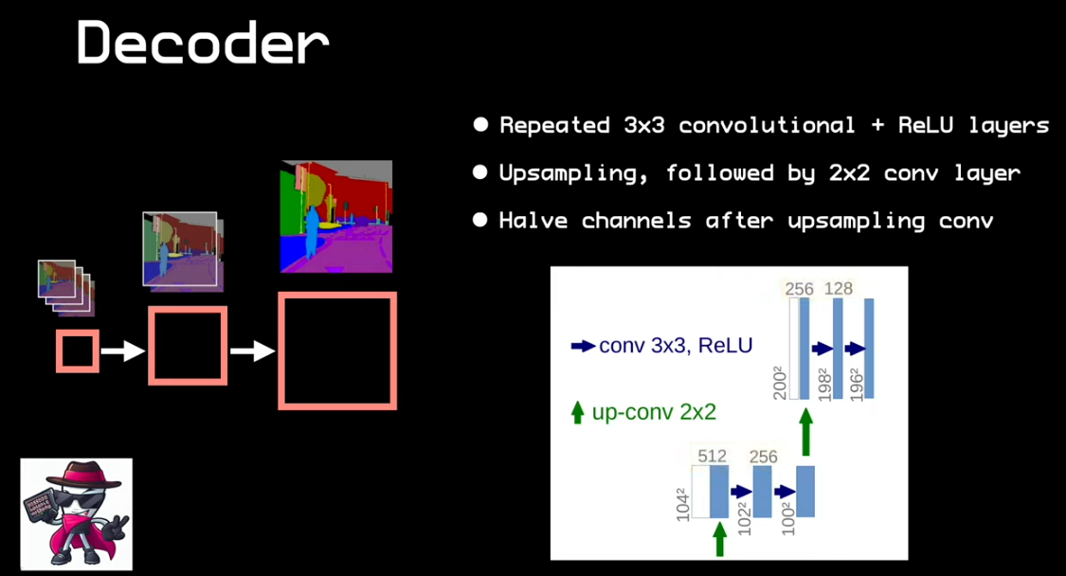

Slide 18
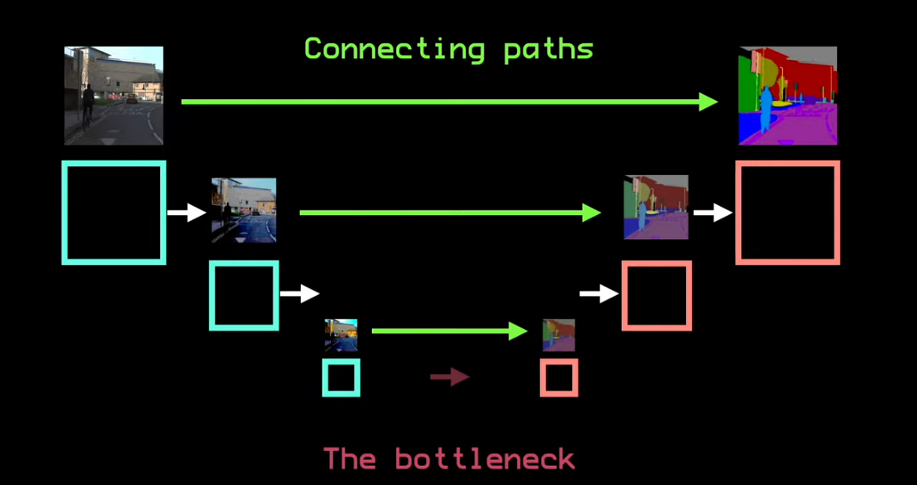

Slide 19
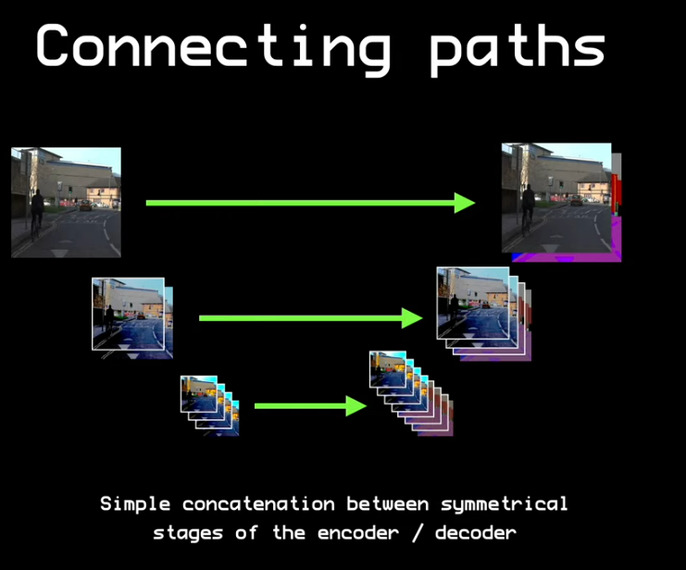

Slide 20
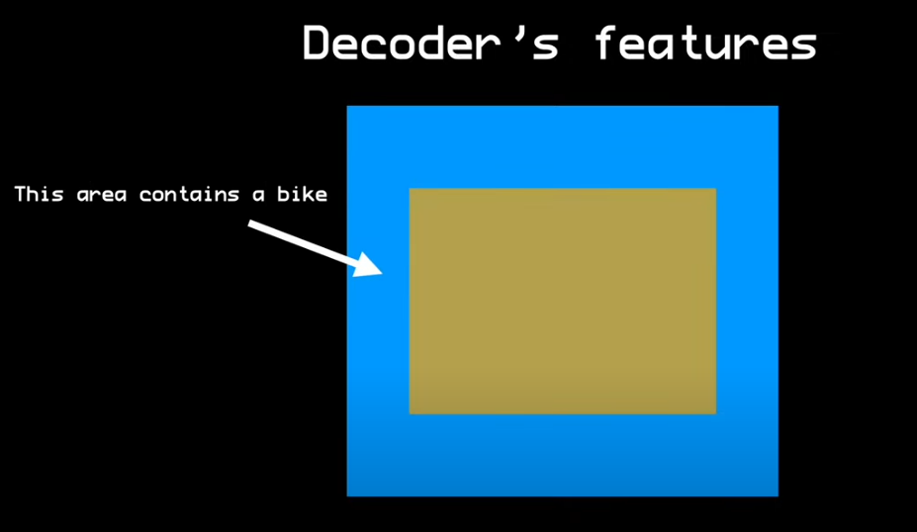

Slide 21
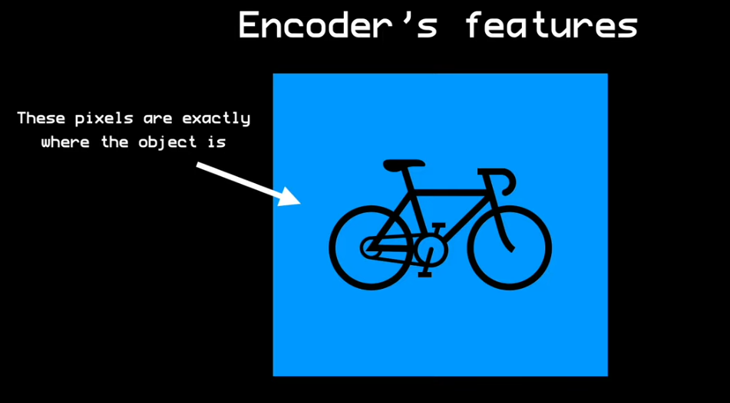

Slide 22
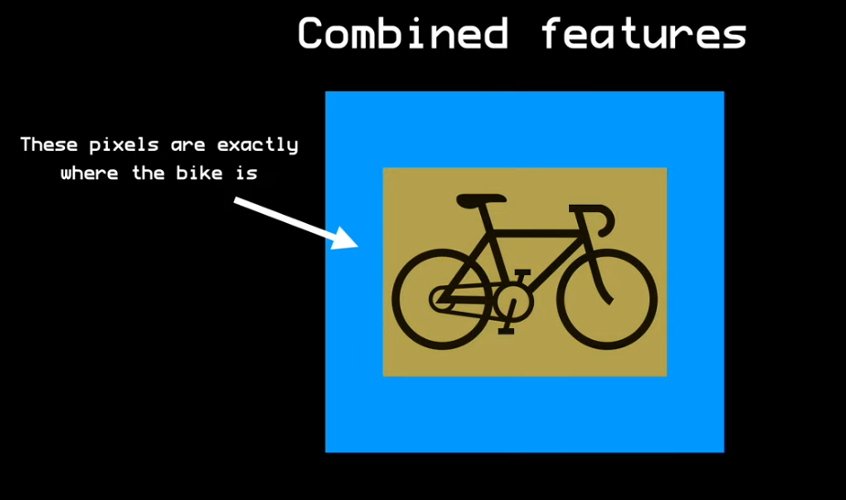

Slide 23
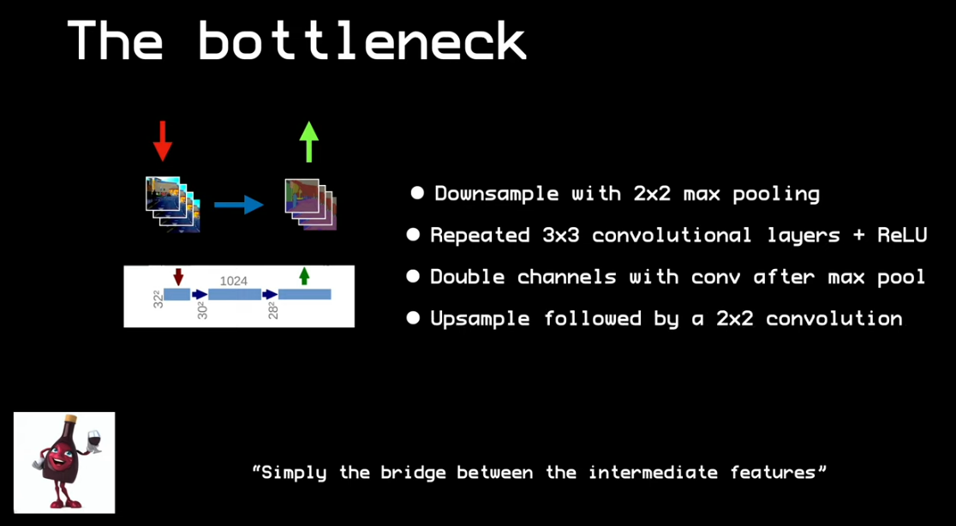

Slide 24
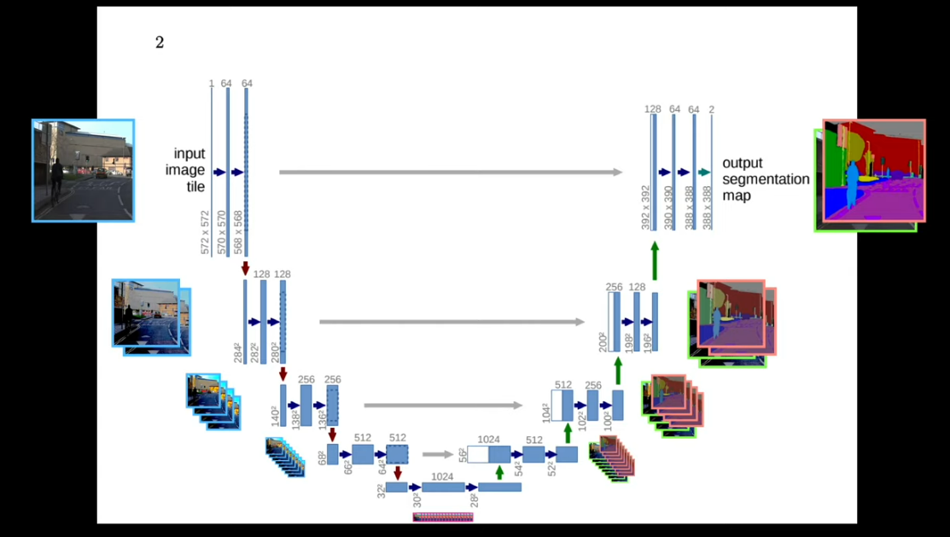

Slide 25
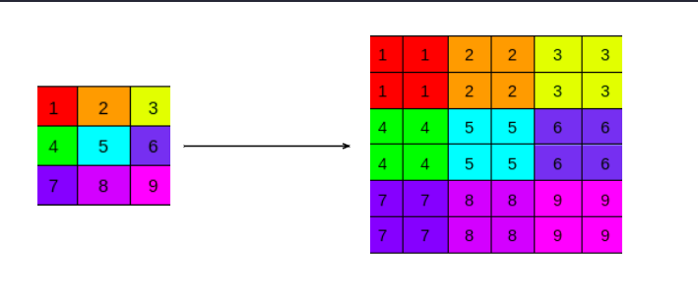

Slide 26
Transposed Convolutional Layer

Slide 27
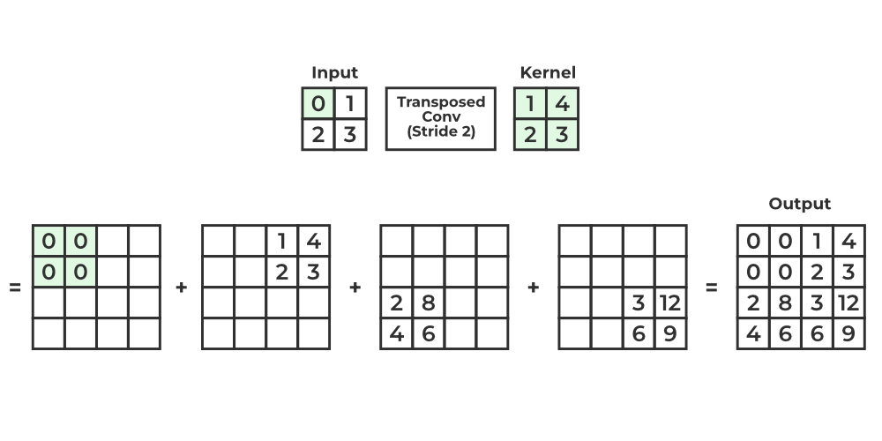

Slide 28
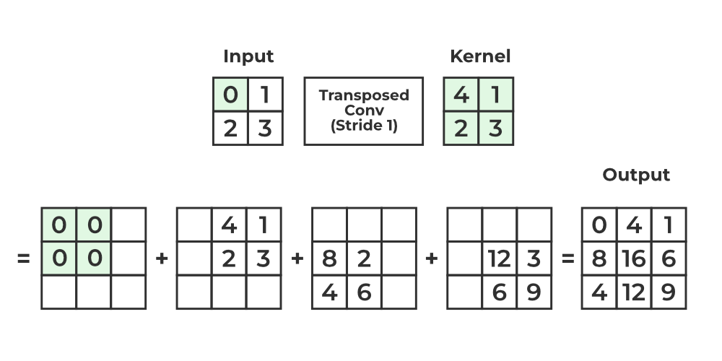

Slide 29
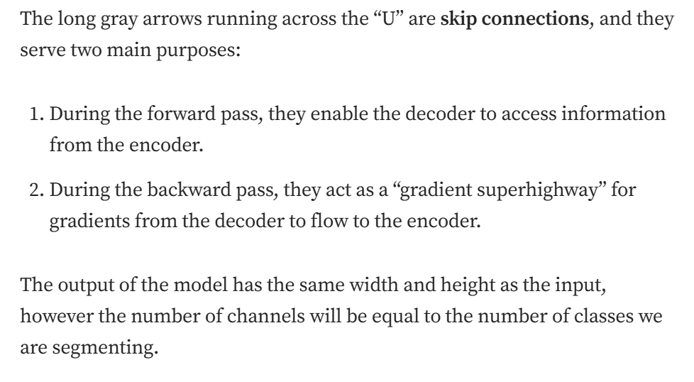
U-Net . . .

Slide 30
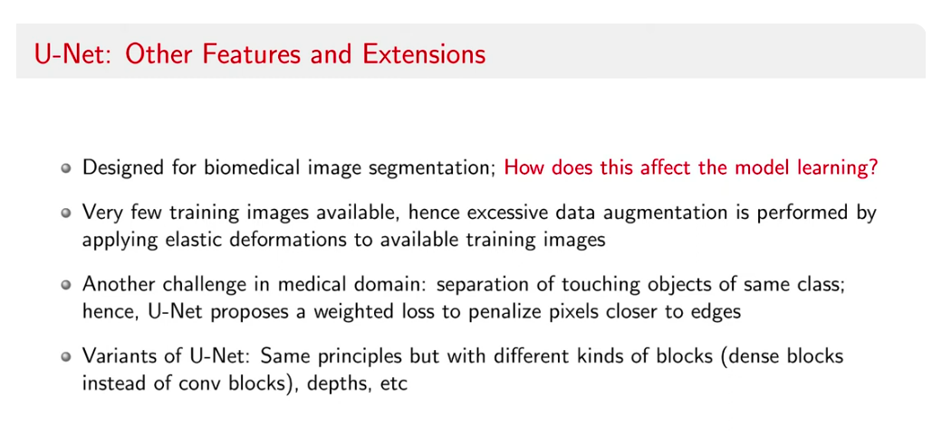

Slide 31
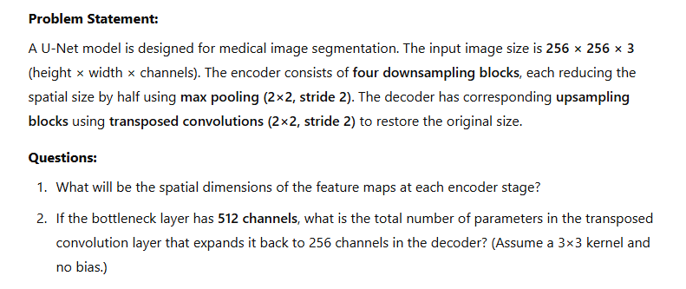

Slide 32
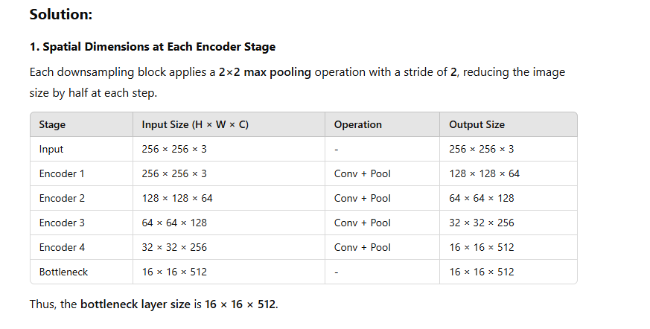

Slide 33
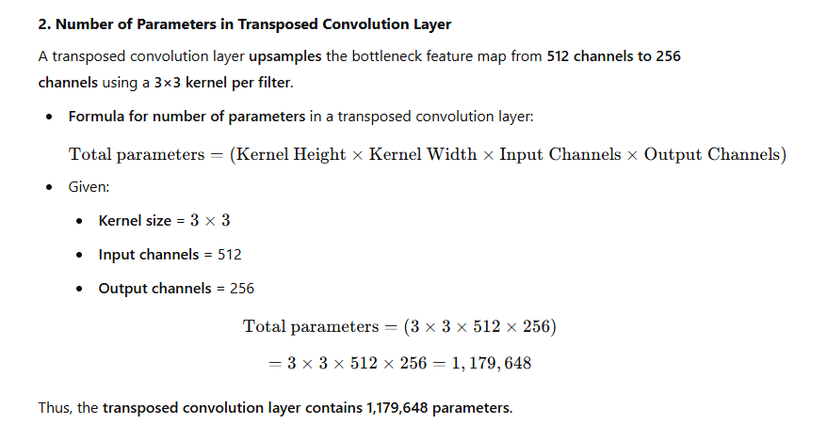

Slide 34
References
https://www.youtube.com/watch?v=NhdzGfB1q74
https://medium.com/@suryatejamenta/upsampler-and-convolution-transpose-layers-7e4346c05bb6
https://www.youtube.com/watch?v=5QUmlXBb0MY&t=11s

